Slide 1
Conserving water and protecting water quality with rain barrels
Lisa Knerr, Environmental Program Manager
720-874-6525, Lknerr@arapahoegov.com

Slide 2
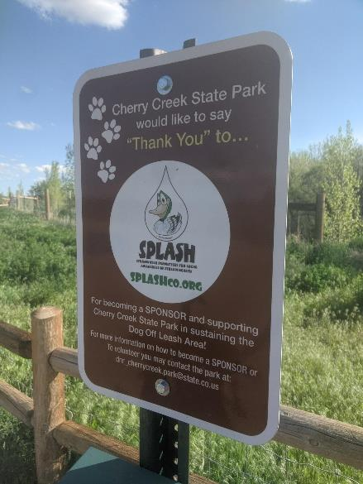
Partners
Colorado State University
One water Solutions Institute
Colorado Stormwater Center (stormwatercenter.colostate.edu)
Splash (stormwater permittees for local awareness of stream health, splashco.org)
Southeast metro stormwater authority
Arapahoe county
Cherry Creek Stewardship Partners/Colorado Watershed Assembly

Slide 3
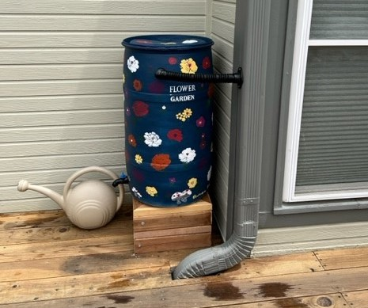
Agenda
Why do we need to conserve water?
What is rainwater harvesting?
Colorado Rain Barrel Regulations
Types of Rain Barrels
Supplies Needed
How to install
Winterizing, Maintenance, FAQ
Decorating Your Barrel

Slide 4
Why Conserve Water?
Notes:
The Front Range is still growing
The average person using about 200 gallons of water per day on indoor and outdoor uses
Half of that is for outdoor use

Slide 5
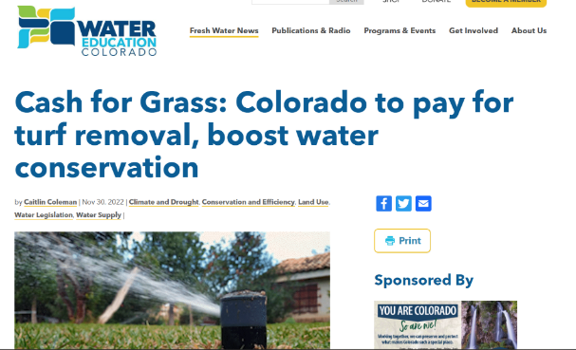
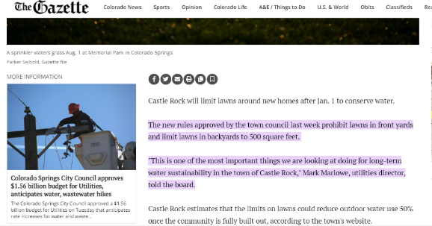
Residential Water Use
Average person in US uses 160-200 gallons per day
~Half of that Goes towards Outdoor Irrigation
Notes:
Water rates are increasing
Some municipalities are restricting nonessential turf”—backyard turf is still okay
In 2022, the Colorado Legislature voted in a Cash for grass program. Grants will go to water providers. In 2023, $2M will not go that far, but it is a start…

Slide 6
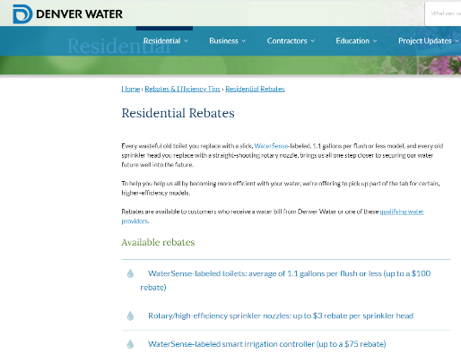
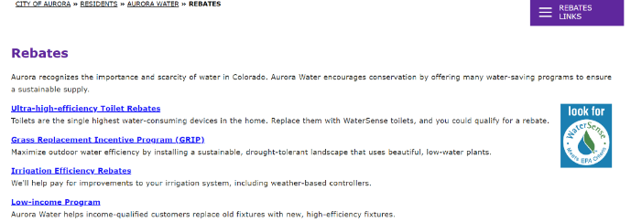
What can we do?
Fix leaks
Install/replace water efficient toilets, Clothes washers, showerheads, etc.
Check for rebates from your water provider
Look for WaterSense Products
Install/Replace Irrigation System Components
Sprinkler Nozzles
Irrigation Controller
Switch to Lower Water Landscaping
Rain Barrel(s)!!

Slide 7
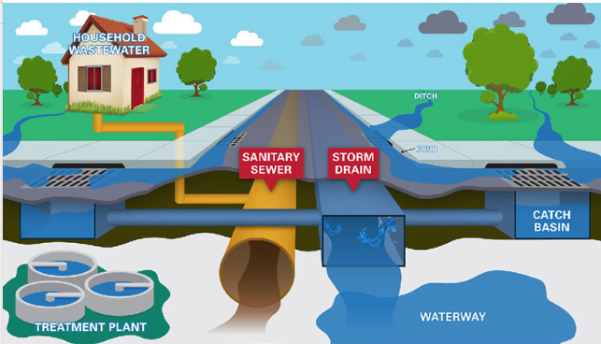
Rain Barrels also Reduce Stormwater pollution

Slide 8
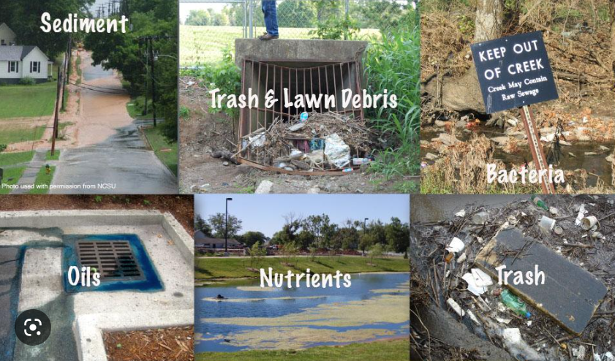
Residential Stormwater Pollution

Slide 9
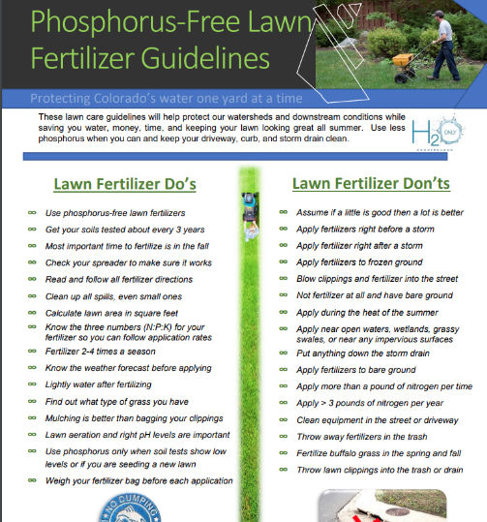
What can We Do?
Pick Up after your pet
Never put anything down the storm drain
Don’t Litter
Maintain your Vehicle
Go P free
Infiltrate more Stormwater Runoff with Rain Barrels!

Slide 10
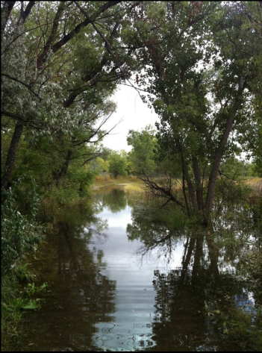
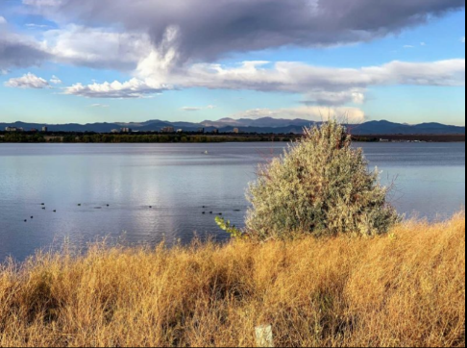
Reduced Stormwater Runoff= Reduced Stormwater Pollution

Slide 11
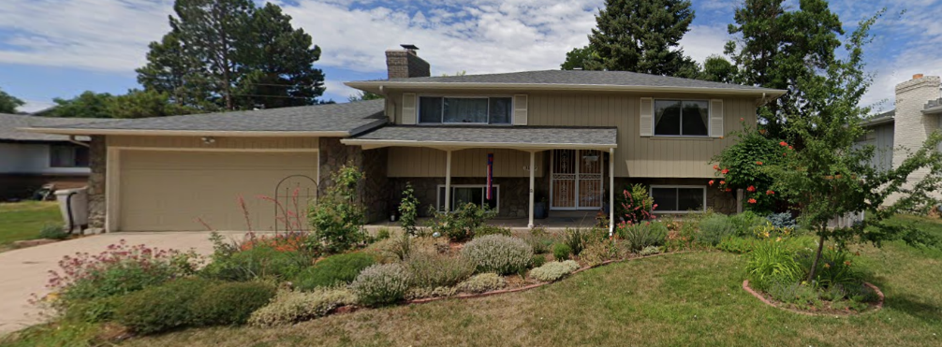
What is Rain Water Harvesting
Collecting, storing, and putting rainwater runoff to use at your house.
Easy to collect via the existing gutter system

Slide 12
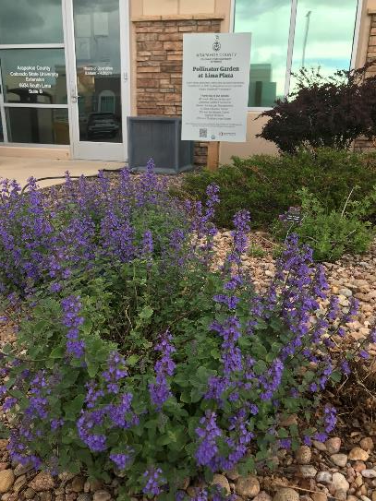
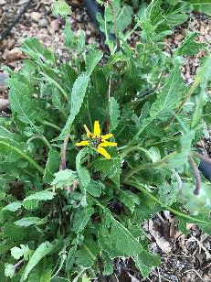
Why Rainwater Harvesting?
It’s free!
Reduced demand for treated municipal water
Plants love it!
Chocolate Flower
Catmint

Slide 13
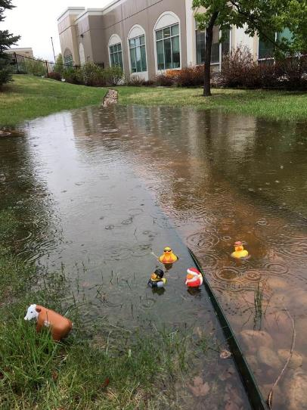
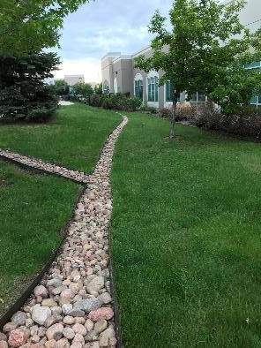
Do we get enough rain?
Greenwood Village
18 inches per year
1 inch of rain x 1,000 sq ft roof=600 Gallons
10,800 gallons per year

Slide 14
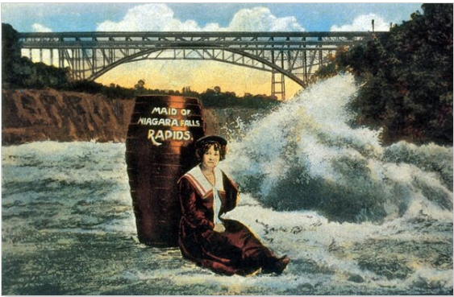
What Can You do With Water from your Rain Barrel?
Vegetable Gardens
Don’t directly water edible parts of veggies
Hanging plants
Greenhouse Plants
Landscaping

Slide 15
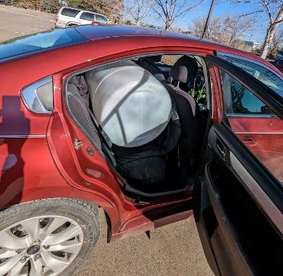
Colorado Rain Barrel Regulations
In 2016, rainwater harvesting was legalized in Colorado for the first time
Maximum of 2 rain barrels with the combined storage of 110 gallons or less
Used for outdoor purposes like watering lawns, plants, or gardens
Container must have a sealable lid to prevent mosquito breeding
Never drink oR cook with water from a rain barrel
It is untreated and may contain contaminates that could harm you or your pets if ingested

Slide 16
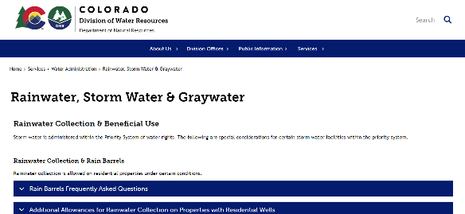
Colorado Rain Barrel Regulation—Wells
Residences that have an exempt residential well permit do not have a limit on how much they can collect
Need a rooftop precipitation collection permit
Have to collect the water from the roof of your primary residence
Additional information with the division of water resources

Slide 17
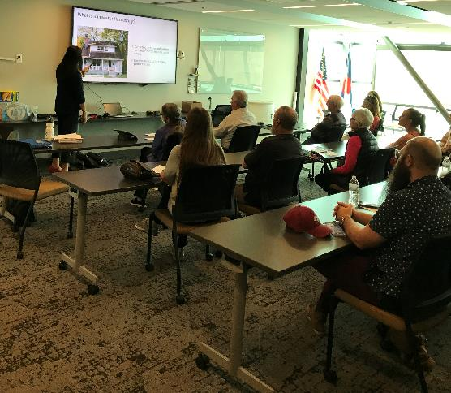
Considerations
Home Owner’s Associations
Check with your HOA before you purchase your rain barrel
May have some aesthetic or location requirements
HOAs cannot prevent you from installing a rain barrel
Winterization needed
Just like your sprinkler system
Think about spigot placement and overflow planning

Slide 18
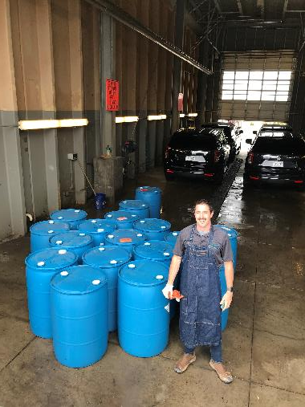
Types of Rain Barrels
Must have a lid
Removable or an access point is best for cleaning
Should be made of Thick plastic
No bags!
Should Have a spigot ~1-3” above the bottom of the barrel
If lower, Can’t use the water
Should not have a top that holds water (mosquitoes!)
Should use a diverter
Keeps Sediment, Leaves, etc. out of the bottom of the Barrel
Easy winterization
Should have an overflow Mechanism
If not using a Diverter

Slide 19
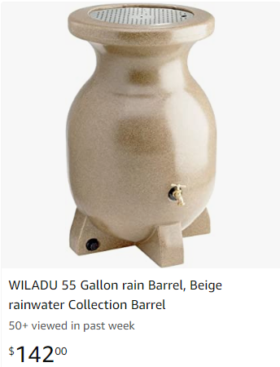
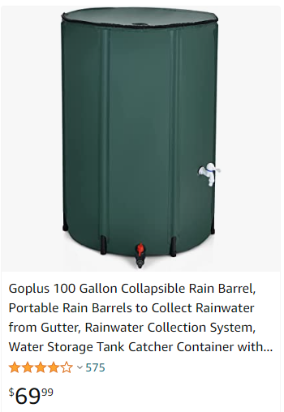
Big holes in top
Spigot too high
Fixed lid (no way to clean barrel)
No overflow
Could spring a leak!
No diverter or screen
No overflow
Planter on top (holds water)
Spigot too high
No lid or access to clean barrel
No overflow

Slide 20
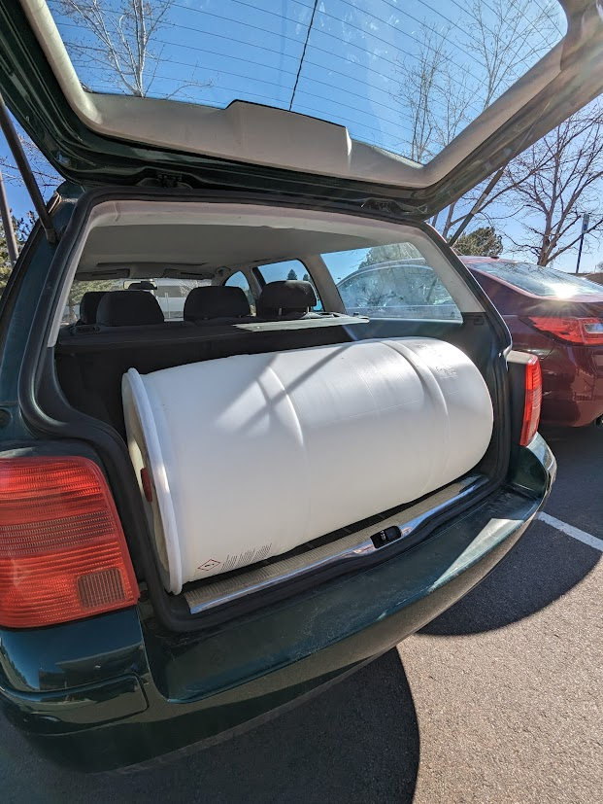
Rain Barrel Materials
Plastic works best
Be careful of metal drums!
Closed top
Removable lid (only remove when cleaning!)
Screw caps
UpcycleD barrels will need additional cleaning

Slide 21
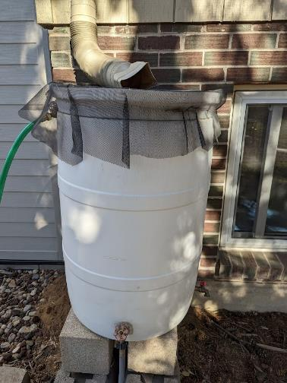
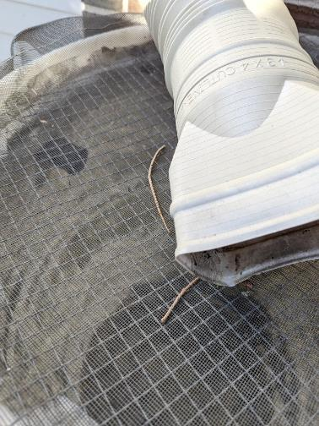
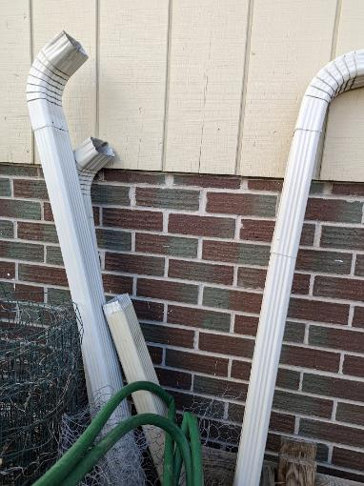
GEN 1(2004…..2016)

Slide 22
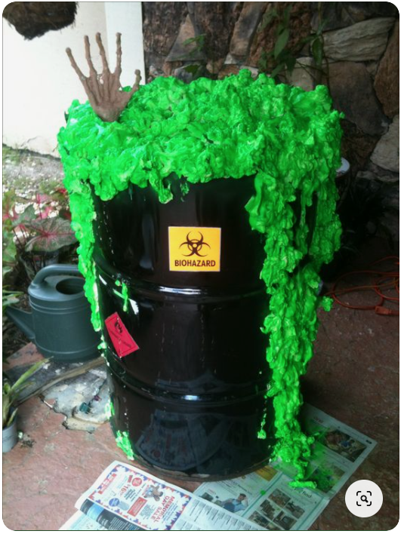
Gen 2
Cheap plastic rain barrels ordered online (expensive!)
Lasted 1-2 years
Split on the bottom

Slide 23
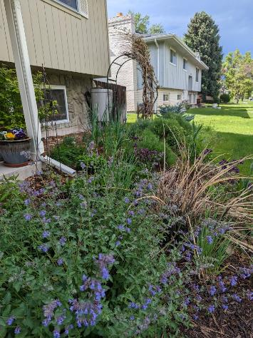
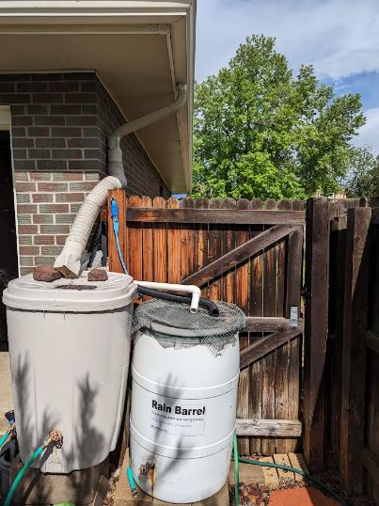
GEN 3 (2019)
So far, so good
Backyard: Tricky downspout
Added another spigot
Now would use a dual spigot/Splitter
Be careful of which side to Drill/Punch Out to add additional barrels

Slide 24
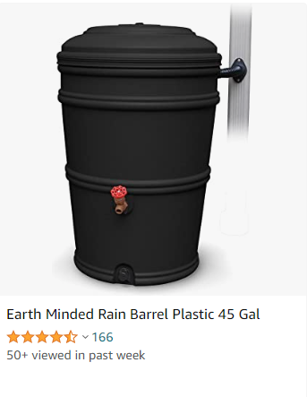
GEN 4 (2021)
The best so far!

Slide 25
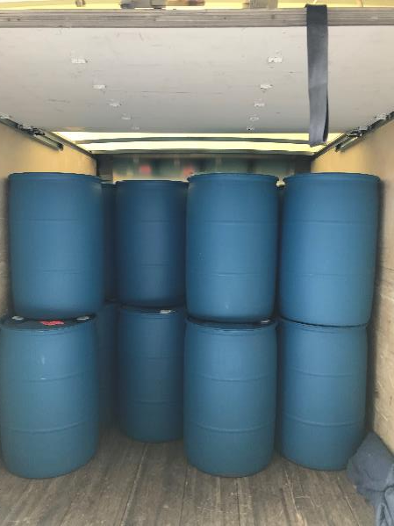
Where to Buy
Colorado Rain Catcher
Container Reclaimer
Blue Barrel
Target, Sam’s, Walmart, Lowe’s, Home Depot, Amazon
BEWARE: Craigslist, Facebook Marketplace

Slide 26
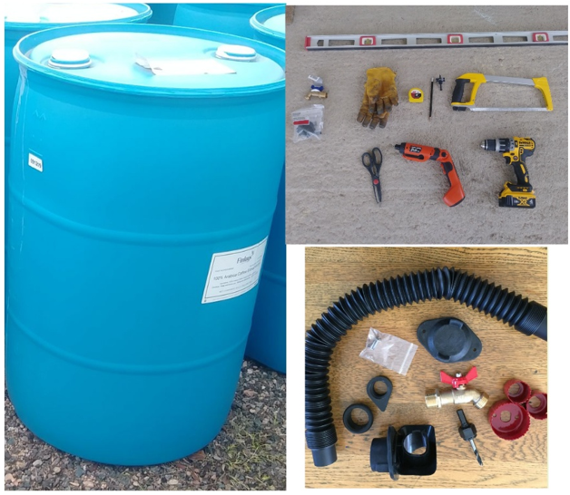
Supplies Needed
Food grade 55-Gallon Barrel with lid
Container Reclaimer (Arvada): $30
Colorado Rain Catchers (Ft. Collins): $50
Rain Barrel Connector Kit
Colorado Rain Catcher ($39.50)
Amazon ($36.92)
Total: ~$70-$90
Colorado Rain Catcher Barrel and Connector Kit ($88)
Tools
Level
Drill
Gloves
Eye Protection
Measuring Tape
Pencil
Etc.

Slide 27
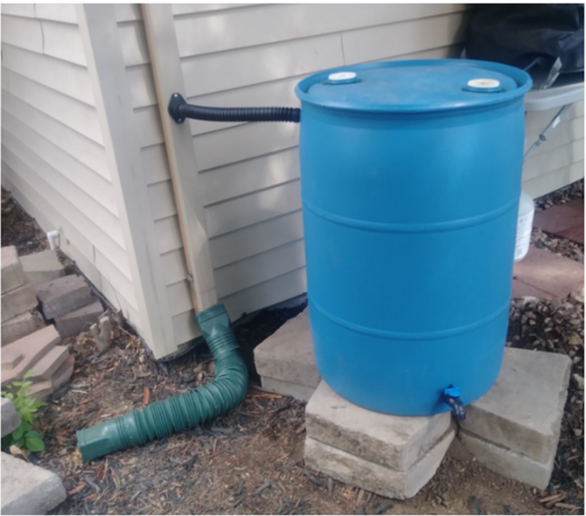
EarthmindeR Diverter
Pros
Easy to install
Do not need to remove the Downspout
Cost effective
Kit includes Hole saws and spigot
Cons
Unable to see clogs
Potential for clogging

Slide 28
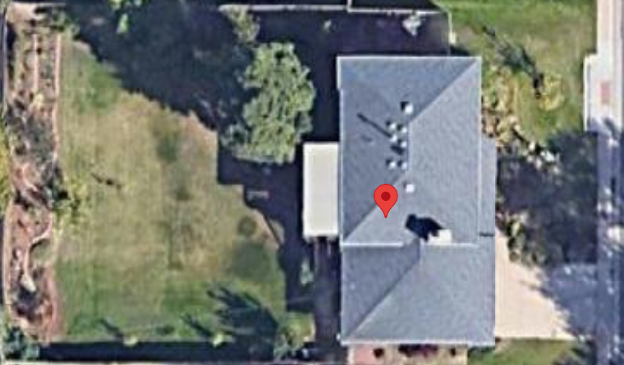
1. Choose a Location
Walk around your home
Find the downspout locations
Choose a location for your rain barrel
Proximity to where you need the water
Easy of making a level base in that area
Catchment area: the amount of water you can collect from that downspout/roof area

Slide 29
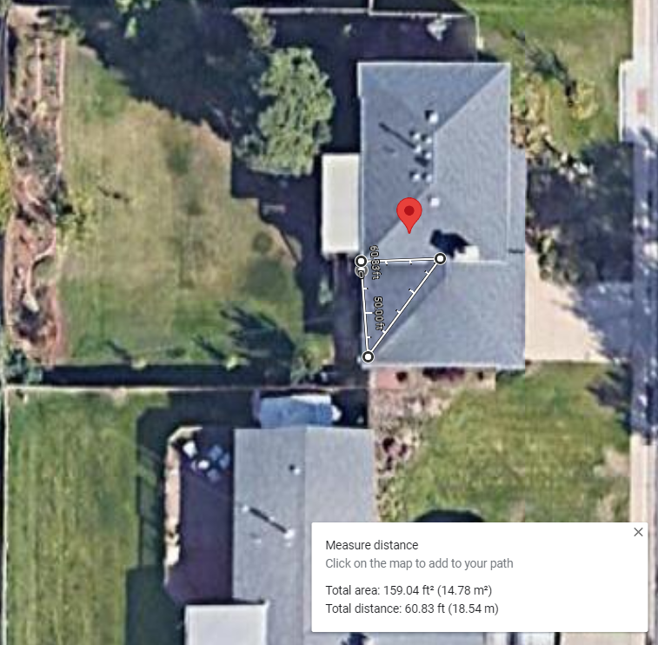
1. Choose a location
Determine the square feet of the Roof area draining to the downspout
Note how the Gutters slope
Calculate
Google the address
Right click to “Measure Distance”
Click to set the measurements and note the “Total Area” in ft2
Calculate the gallons that you can collect
Catchment area (ft2) x Rainfall (ft) X 7.48 gal/ft3= Total Rainwater (gal)
159 ft2 X 0.08 ft x 7.48 gal/ft3 = 95 gallons from a 1 inch storm for this small portion of the roof
1 inch = 0.08 ft

Slide 30
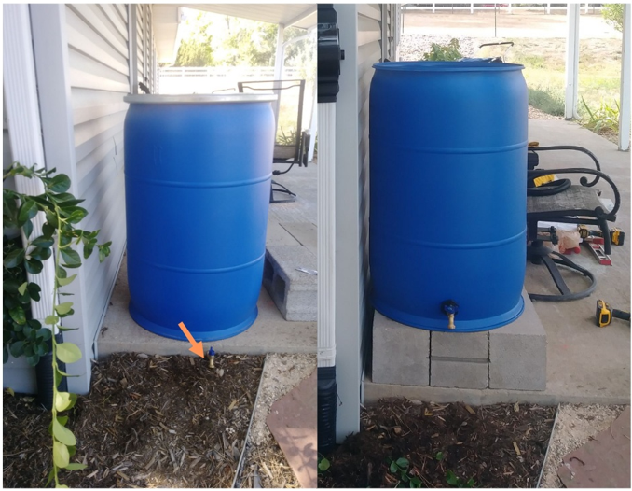
2. Create a base
Rain barrels are very heavy! Children must always be supervised about rain barrels.
Select a flat location within 3 feet of a downspout
A Base Creates water pressure
Purchase a commercially available rain barrel stand or construct a simple base with wood, cinder blocks, bricks, or extra patio pavers
Full rain barrels weigh nearly 500 pounds!!

Slide 31
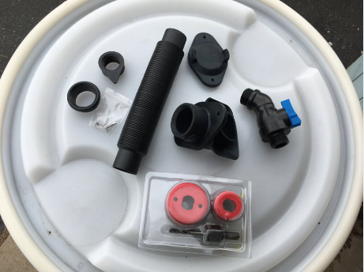
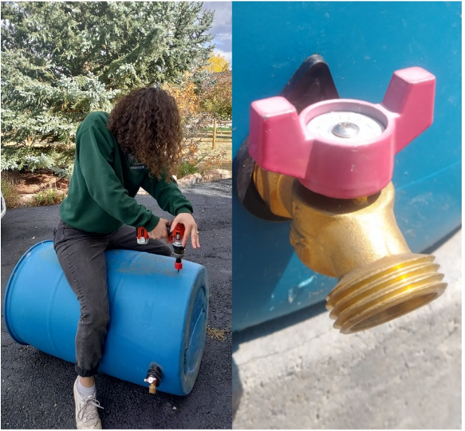
3. Drill a Spigot Hole in your Barrel
Sitting on the barrel gives you greater control
Measure 3 inches up from the bottom of the barrel and make a mark
Carefully drill the spigot hole using the Smallest hole saw
Insert the Fitting-use soap
Screw the spigot into the fitting by hand
Make sure the spigot is closed after you finish the installation

Slide 32
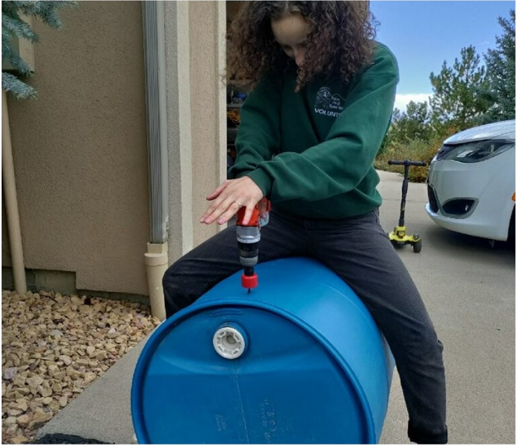
4. Drill a Fill Hole and Connect Hose
Consider the location of the barrel before drilling the fill hole
The hole should be on the side of the barrel closest to the downspout
Consider if you will add more barrels (will need room for the connector hose)
Measure 3 inches down from the top of the barrel and make a mark
Carefully drill the Fill hole using the medium hole saw
Insert the rubber fitting and hose

Slide 33
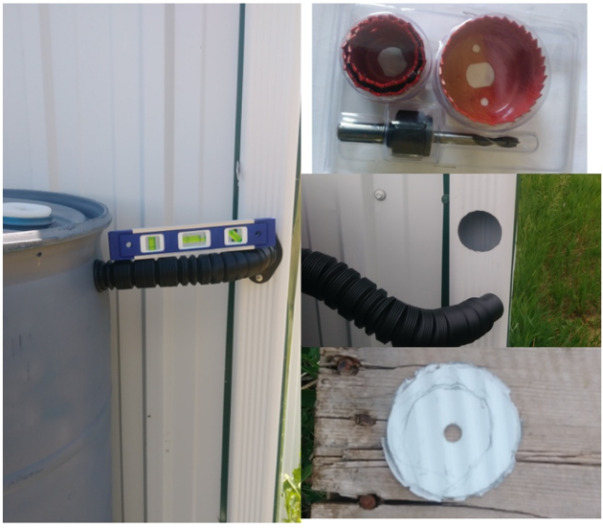
5. Install the Diverter in the Downspout
Warning: Always wear eye protection and gloves when drilling metal
Measure your downspout. Always drill on the 3 inch side of your downspout
Your downspout could be 2”x3” or 3”x2”
Place your barrel on the stand with the spigot and fill hose in the correct location
Use a level to mark the height of the fill hose
The fill hose must be level to allow extra rain water to flow back out the downspout. If the fill hose is not level, water will overflow out of the top of the rain barrel (too high) or not fill (too low)
Carefully drill the Diverter hole using the Largest hole saw into the 3 inch side of the downspout

Slide 34
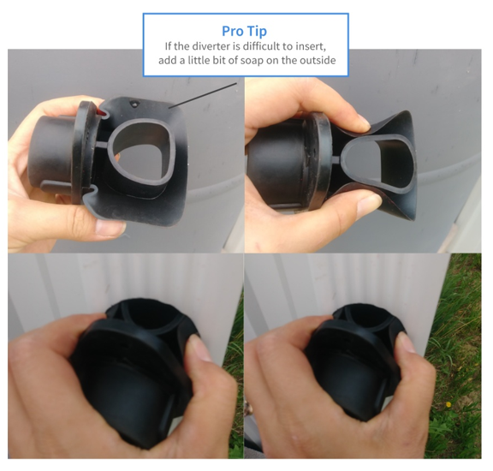
5. Install the Diverter in the Downspout
Install the flexifit diverter
Squeeze the side of the rubber diverter and insert into the downspout
The cup and arrow should be facing up
Secure the diverter to the downspout with the two self-tapping screws
Insert the fill tube to the diverter and into the barrel’s top hole
Make sure the diverter is completely flush (no gaps!) and all the way inserted into the downspout
Listen for the “pop”

Slide 35
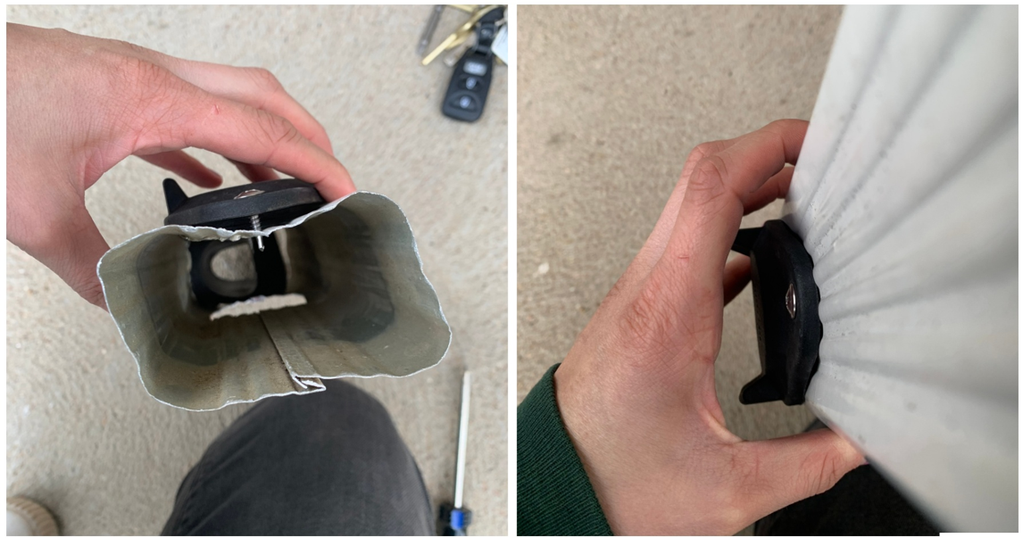

Slide 36
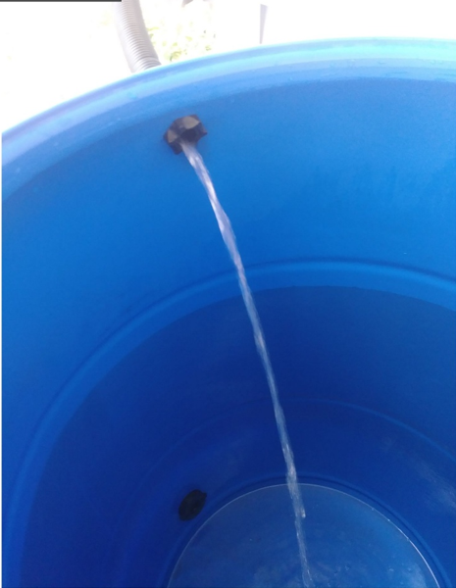
Test Your System

Slide 37
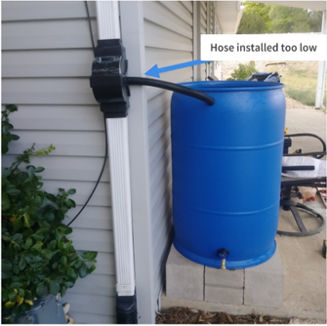
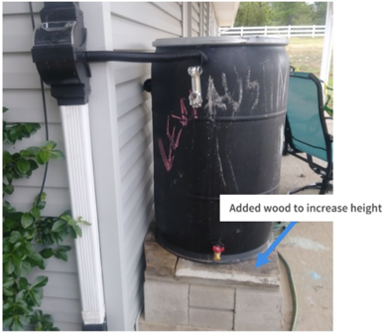
Troubleshooting

Slide 38
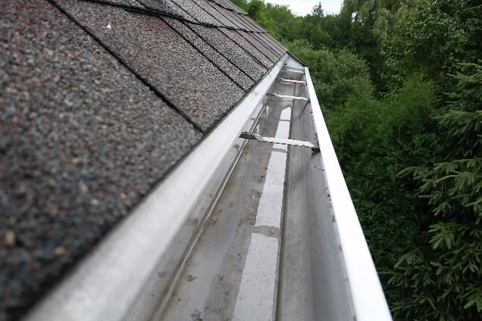
Troubleshooting
OR…

Slide 39
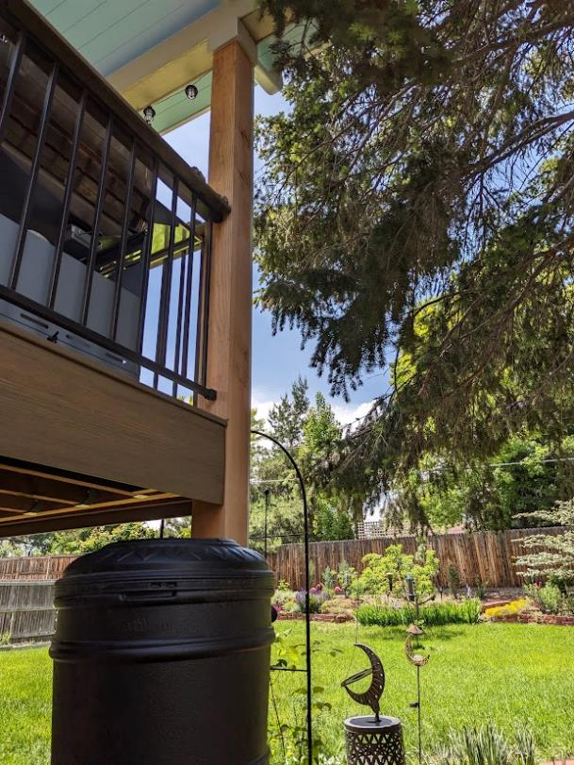
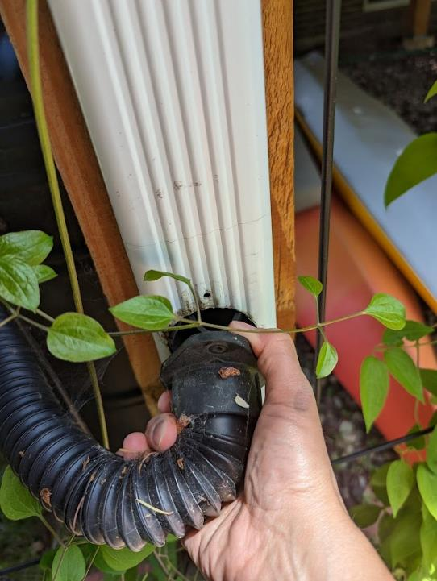
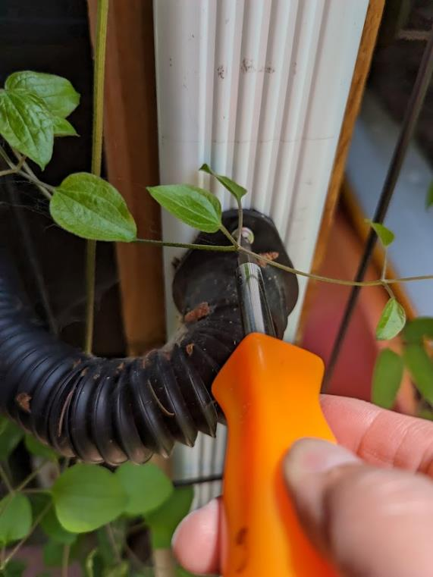

Slide 40
7. Optional: Install the tube for Two barrels
Kit sold separately
Installation Adjustment—drill an additional intake hole on first barrel
Connector pipe must be level and below the intake hole of the first barrel

Slide 41
Winterizing Your Rain Barrel
Empty Barrel
Remove diverter and install winterization cap on downspout
Tip: turn diverter upside down in downspout. Wiggle and squeeze the diverter.
The winterization cap may be difficult to push into the downspout. Use self tapping screws to secure in place.
Check the winterization cap for leaking.
Remove any debris from tubing.
Leave barrel in place or store for winter.
Barrel may blow over if windy.

Slide 42
Winterizing

Slide 43
Winterizing

Slide 44
Maintenance
Clean out gutters in spring before connecting barrel
Gutter covers can help (optional)
Wait to connect the barrel until the second rain in the spring
Rinse out barrel to prevent algae blooms
Can use a long handled brush
Use the water in your barrels

Slide 45
FAQ
Will collecting water off of an asphalt roof leach pollutants?
Is it safe to use rainwater on a garden?
Will algae grow in my rain barrel?
How do I keep leaves and particles out of my barrel?
Can mosquitoes still get in my barrel?
Mosquito dunk—harmless to pollinators and wildlife and safe on plants
Should I put weights on the top of my barrel?
Probably not! Barrels can weigh up to 500 pounds and extra weight on the top might make it unstable.

Slide 46
Decorating Your Barrel
Decorate BEFORE installation or remove rain barrel from house before decorating
Use sand paper (100 weight)
Wipe down and allow to dry
Spray plastic paint primer—paint will not stick with it!
30 minute dry time
Rust-oleum 2x ultracover primer for plastic
Create your own design
Can use cardboard stencils
For artistic barrels
Use acrylic paint
Protect your work by spraying with a paint sealer

Slide 47
Decorating Your Barrel

Slide 49
Accessorizing Your Barrel

Slide 50
Questions?

Slide 51
Pick Up Your Rain Barrels

